Slide 1
Statistics 367-1-4361 PyMC and Sampling
Opher Donchin

Slide 2
3A Review

Slide 3

Kahoot review

Slide 4
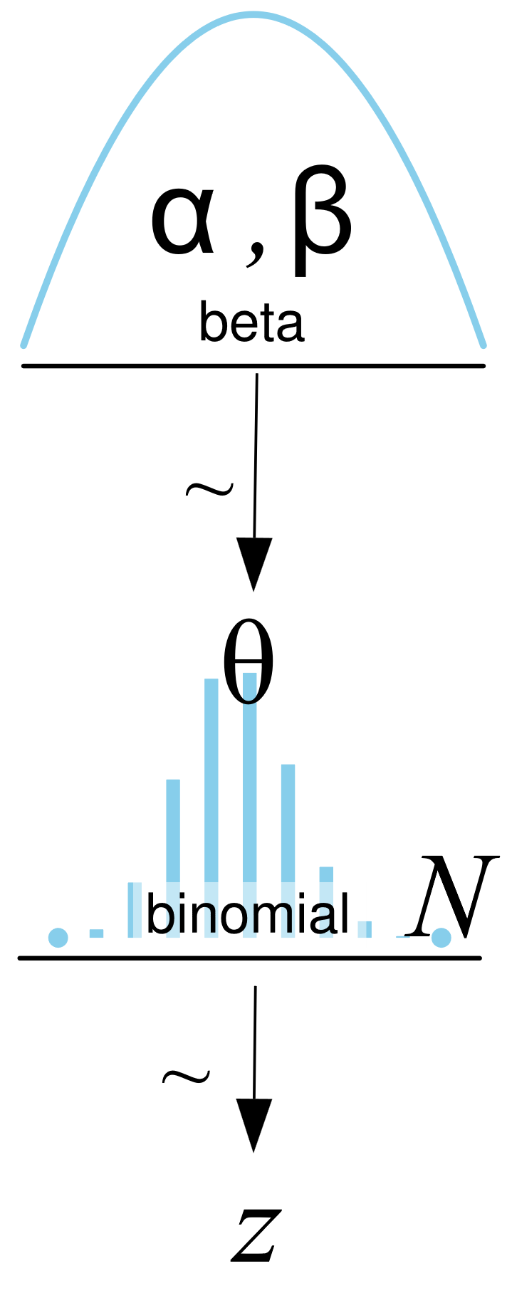
Models
Can write the model with equations or pictures

Slide 5
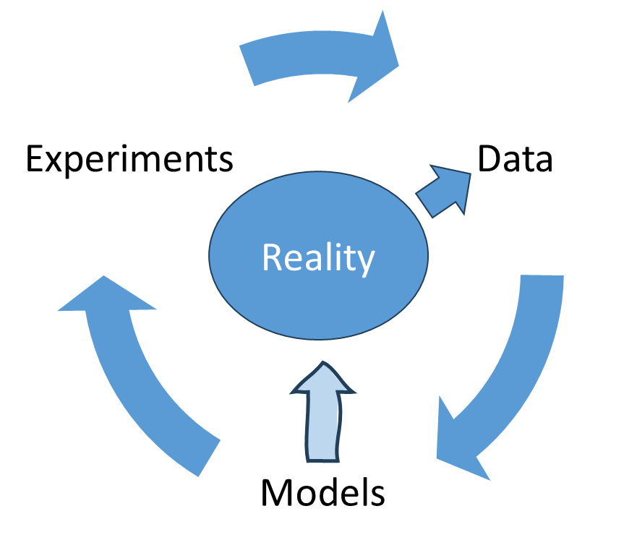
Baye’s rule updates models

Slide 6
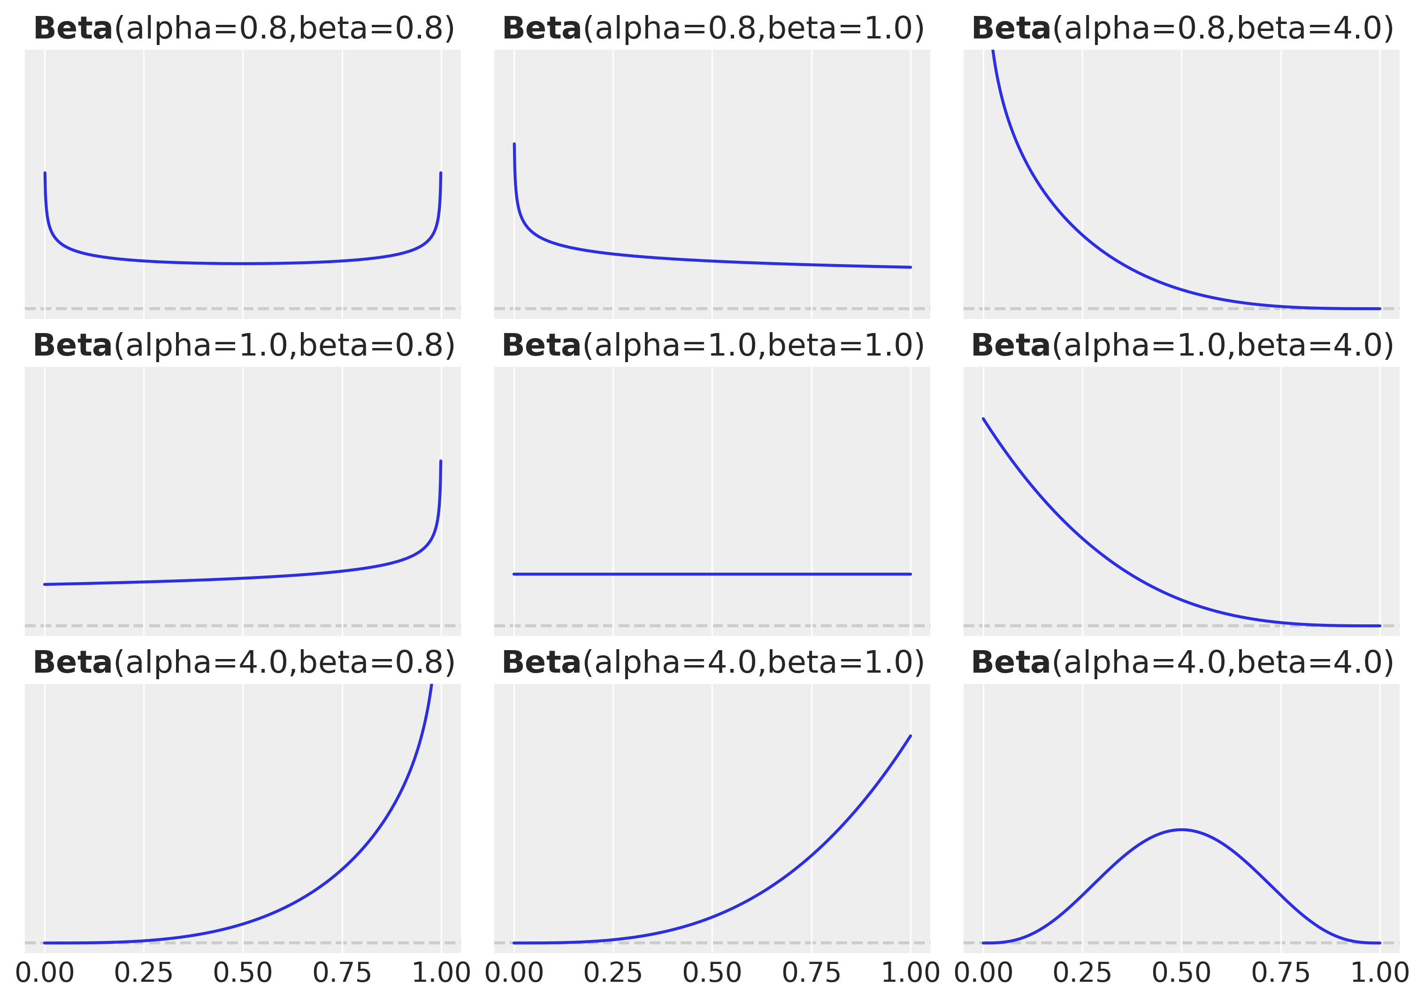
The beta prior for the binomial likelihood
Flexible
Conjugate
Interpretable

Slide 7
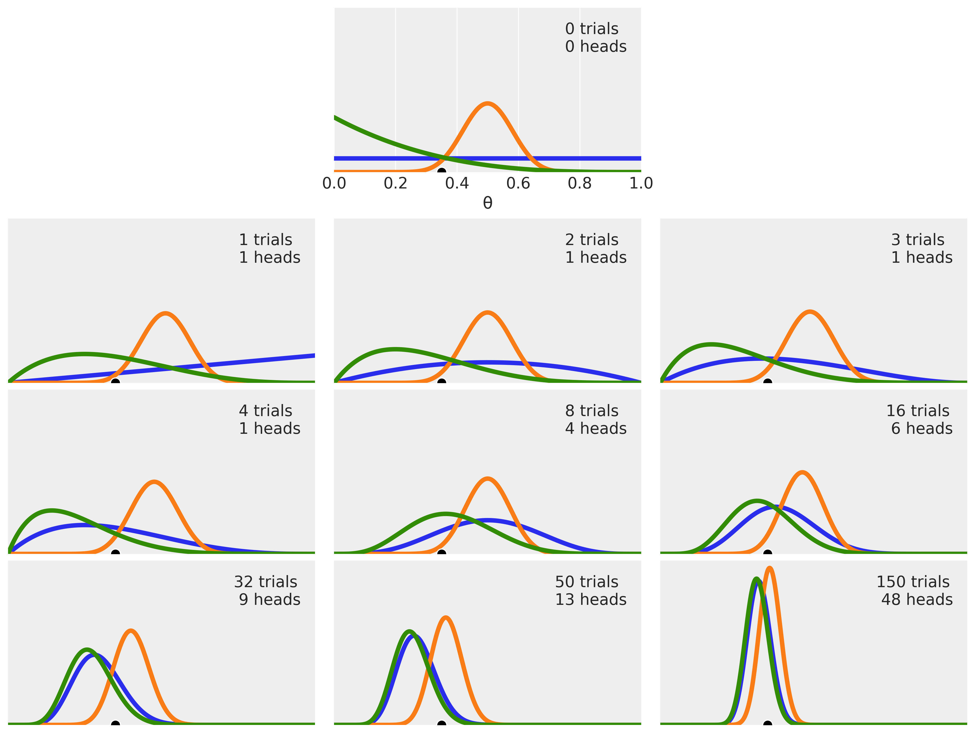
Prior and likelihood interact to produce posterior
More data
Sharper posterior
Overwhelms prior
Prior can still matter

Slide 8
3B A brief history of Bayesian Data Analysis

Slide 9
A history of Bayesian data analysis
The ancient world: 1930s-1950s
Rapid technological growth
Cultural flowering
Philosphical foundations
Purely analytical and mathematical approaches

Slide 10
A history of Bayesian data analysis
The ancient world: 1930s-1950s
The dark ages: 1950s-1980s
Bayesian data analysis becomes a rarely visited backwater
The frequentist empire expands
Technological developments
Widespread scientific and popular acceptance
Enormous worldwide influence
Early computers could do frequentist computations
But they couldn’t solve integrals to find the posterior distribution
Bayesian statistics is only tractable on very simple, toy examples

Slide 11
A history of Bayesian data analysis
The ancient world: 1930s-1950s
The dark ages: 1950s-1980s
The renaissance: early 1990s
New technologies fuel excitement
Technology creates a cascade of improvements
Monte-carlo Markov chain (MCMC) sampling promises good approximate solutions
Metropolis-Hastings and Gibbs sampling show the approach is feasible
Bayesian methods move from the mathematical to the computational world

Slide 12
A history of Bayesian data analysis
The ancient world: 1930s-1950s
The dark ages: 1950s-1980s
The renaissance: early 1990s
The industrial revolution: mid 1990s-early 2000s
Craftsmen and artisans are replaced with automated processes
The new machines are efficient but also clunky and dangerous
Automation leads to a sharp growth in efficiency and productivity
Early probabilistic programming languages PPLs like BUGS make MCMC available without programming the whole algorithm

Slide 13
A history of Bayesian data analysis
The ancient world: 1930s-1950s
The dark ages: 1950s-1980s
The renaissance: early 1990s
The industrial revolution: mid 1990s-early 2000s
The modern age: 2000s-2010s
Increasing use of probabilistic programming languages
Increasing acceptance of Baysian approaches
New generations of PPLs introduced

Slide 14
A history of Bayesian data analysis
The ancient world: 1930s-1950s
The dark ages: 1950s-1980s
The renaissance: early 1990s
The industrial revolution: mid 1990s-early 2000s
The modern age: 2000s-2010s
The information age: 2020s
Big data
Knowledge automatization
Increasing rates of change

Slide 15
3C Probablistic Programming Languages

Slide 16
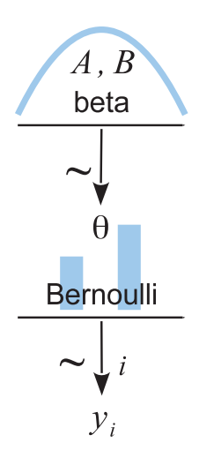
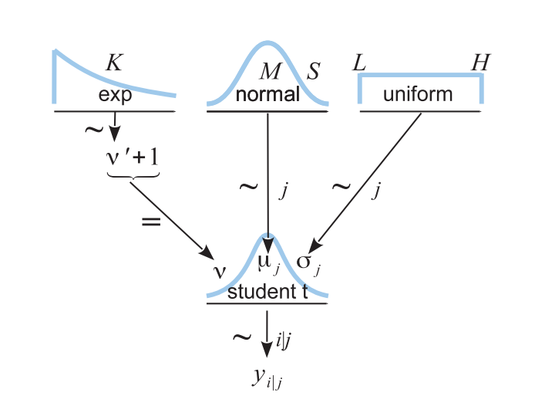
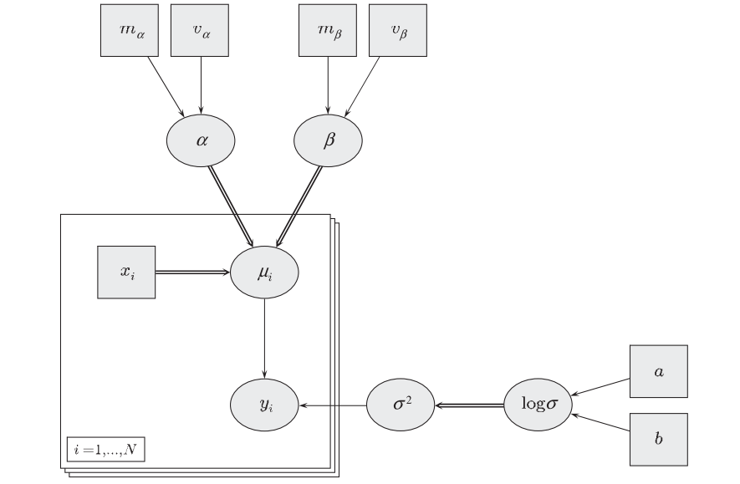
Bayesian networks / Graphical models
!

Slide 17

Translating a graphical model to a PPL
Equations
Graphical model
PyMC (a PPL)
with pm.Model() as our_first_model:
θ = pm.Beta('θ', alpha=1., beta=1.)
y = pm.Bernoulli('y', p=θ, observed=data)
idata = pm.sample(1000, random_seed=4591)
Three representations of the same idea

Slide 18
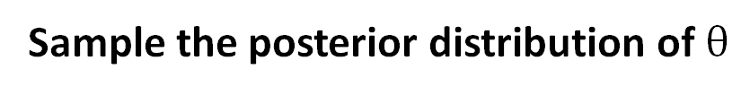
Sampling the posterior for fake data
Generate some fake data
trials = 4
theta_real = 0.35 # unknown value in a real experiment
data = pz.Binomial(n=1, p=theta_real).rvs(trials)
Create a Bayesian model
with pm.Model() as our_first_model:
θ = pm.Beta('θ', alpha=1., beta=1.)
y = pm.Bernoulli('y', p=θ, observed=data)
Sample the posterior distribution of $θ$
idata = pm.sample(1000, model=our_first _model, random_seed=4591)

Slide 19
3D Sampling

Slide 20
Why sample?
Analytic solutions not always available?
Must choose a likelihood with a conjugate prior
Must have a conjugate prior that fits
Grid solution often too limited
Works great for 1 parameter
Becomes quickly untenable for more than 2 or 3 parameters
We’ll learn it on one parameter, just to make things simple

Slide 21
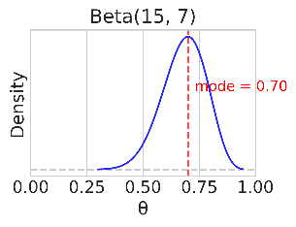
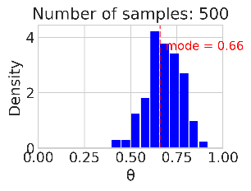
Sampling
We can sample in order to characterize a distribution

Slide 22
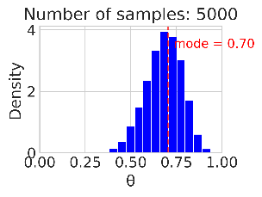
Sampling
We can sample in order to characterize a distribution
Larger samples give more accuracy

Slide 23
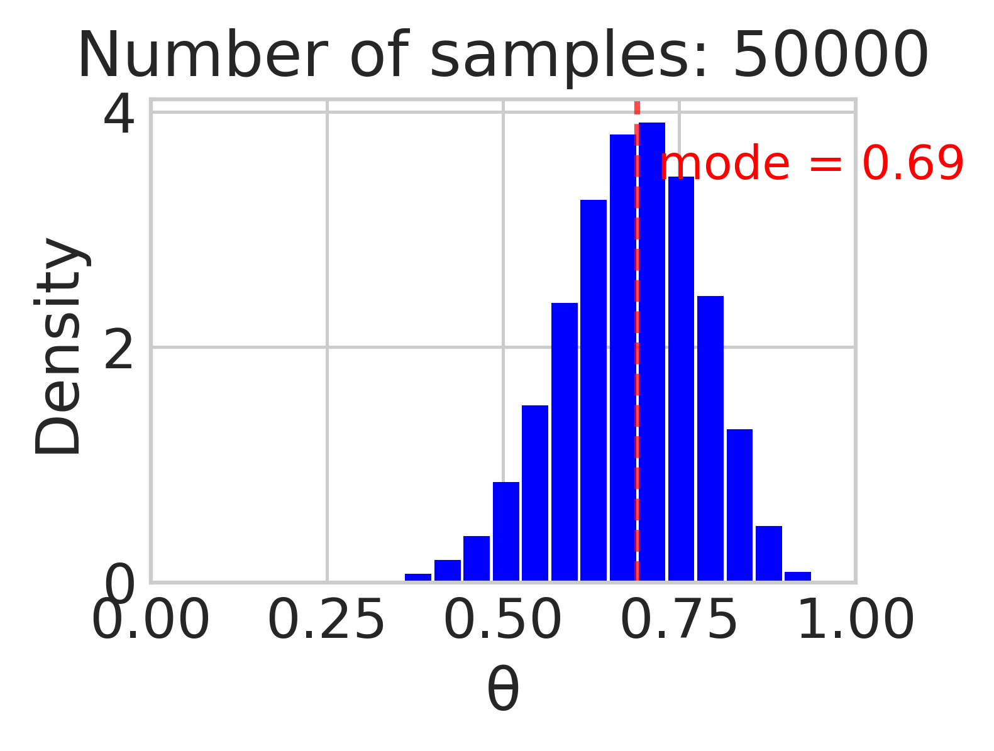
Sampling
We can sample in order to characterize a distribution
Larger samples give more accuracy
With a sample we can estimate parameters

Slide 24
Sampling and PPL
A PPL will have at least two parts:
Model building
Sampling
with pm.Model() as our_first_model:
θ = pm.Beta('θ', alpha=1., beta=1.)
y = pm.Bernoulli('y', p=θ, observed=data)
idata = pm.sample(1000, model=our_first _model, random_seed=4591)

Slide 25
3E PyMC

Slide 26
PyMC structure
Preliz
Specialized applications
PyMC
Distributions
Samplers
Models
Arviz
Utilities
Variational Bayes
Bambi

Slide 27
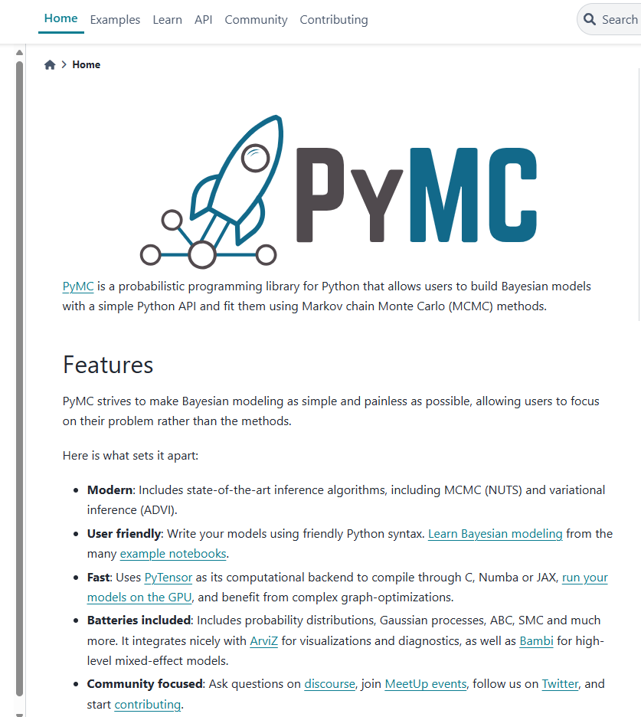
PyMC: a PPL for Python

Slide 28
Evolution of PPLs
Bugs (1989-1996)
Unix / Modula2
Sampling: 3 different samplers
WinBugs (1996-2008)
Windows / Component Pascal
Geological (2 dimensional) modelling
Doodle
OpenBugs (2004- )
Multi-platform
More flexible
Jags (2007- )
C++
Extensible
Stan (2012- )
C++
Compiles the sampler
Gradient-based methods
PyMC and many others
Python or R based

Slide 29
Two flavors of PPL
Separate language
Embedded in the code
data {
int<lower=0> N;
vector[N] y;
real mu_mu;
real<lower=0> sd_mu;
real<lower=0> sd_sd;
}
parameters {
real mu;
real<lower=0> sd;
}
model {
// Priors
mu ~ normal(mu_mu, sd_mu);
sigma ~ normal(0, sd_sd);
// Likelihood
y ~ normal(mu, sd);
}
N = 100
y = np.random.normal(0, 1, N)
mu_mu = 0
sd_mu = 1
sd_sd = 1
coords = {"data": np.arange(N)}
with pm.Model(coords=coords) as model:
mu = pm.Normal("mu", mu=mu_mu, sigma=sd_mu)
sd = pm.Normal("sd", mu=0, sigma=sd_sd)
y = pm.Normal("y", mu=mu, sigma=sd, observed=y)

Slide 30
3E Inference Data Objects

Slide 31
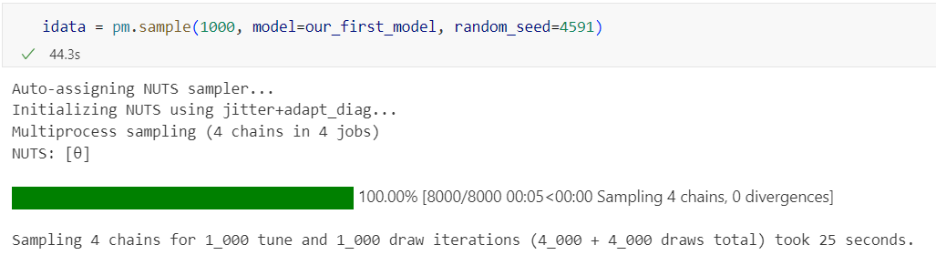
What happens when we call pm.sample()?
Pick a sampling algorithm
Initialize
Run multiple chains

Slide 32
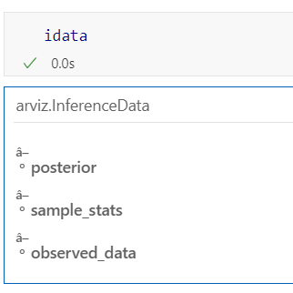
We get an inference data object
It has 3 groups
So far
Each group is an xarray Dataset

Slide 33
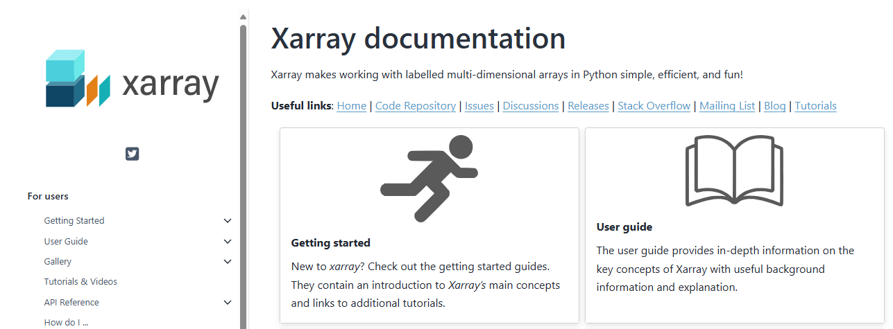
xarray
xarray Dataarrays extend Pandas dataframes to multiple dimensions
Each dimension and coordinate can have a name
Xarray datasets combine multiple Dataarrays
With shared dimensions

Slide 34
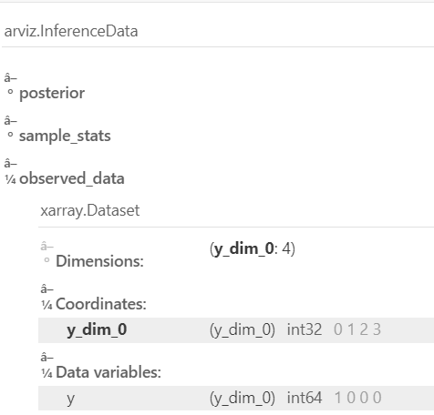
Observed_data is an xarray DataArray with the actual data
Four coin flips
1 head
3 tails

Slide 35
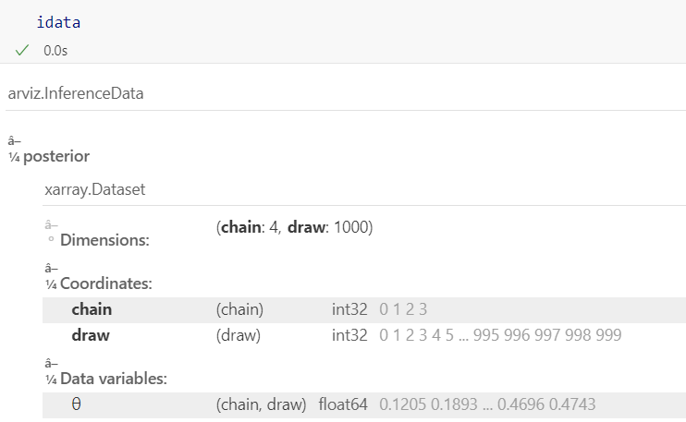
posterior has the samples
One variable: θ
Two dimensions: chain and draw
4,000 samples

Slide 36
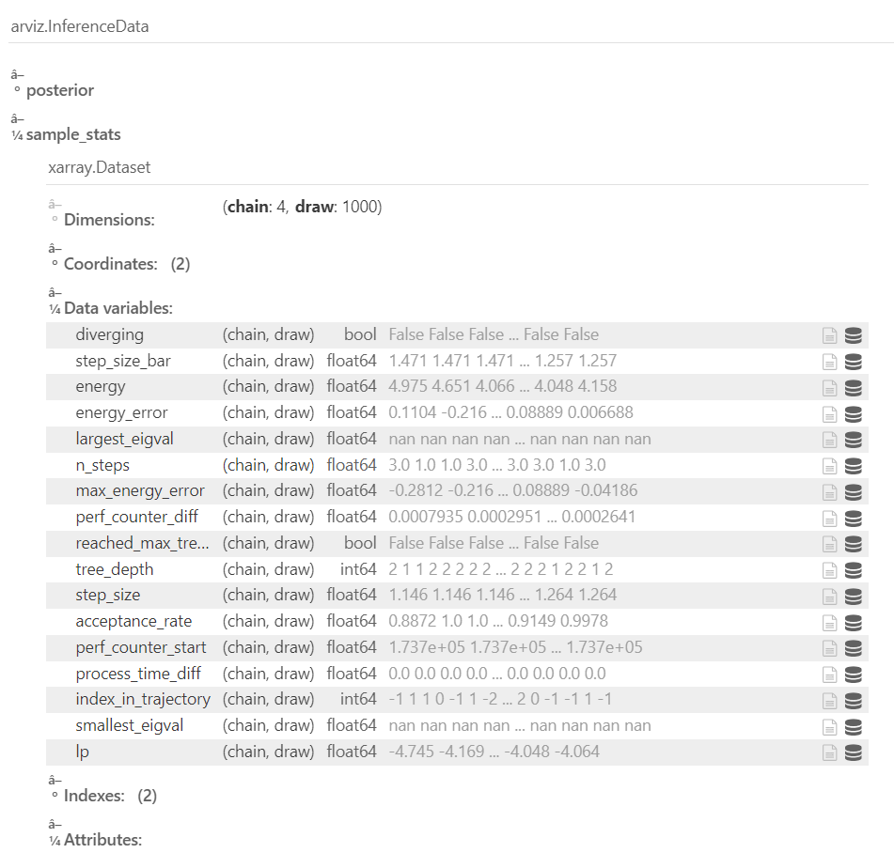
Sample stats contains data about sampling
Can be safely ignored for now

Slide 37
3E The posterior distribution

Slide 38
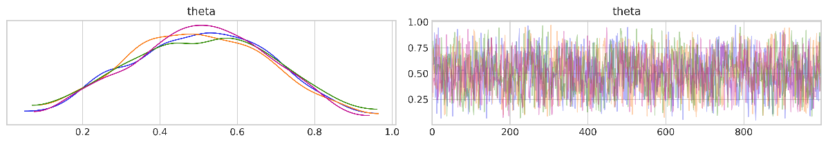
Sampling the posterior for fake data
Sample the posterior distribution of $θ$
idata = pm.sample(1000, model=our_first _model, random_seed=4591)
Plot the samples
az.plot_trace(idata, chain_prop='color')

Slide 39

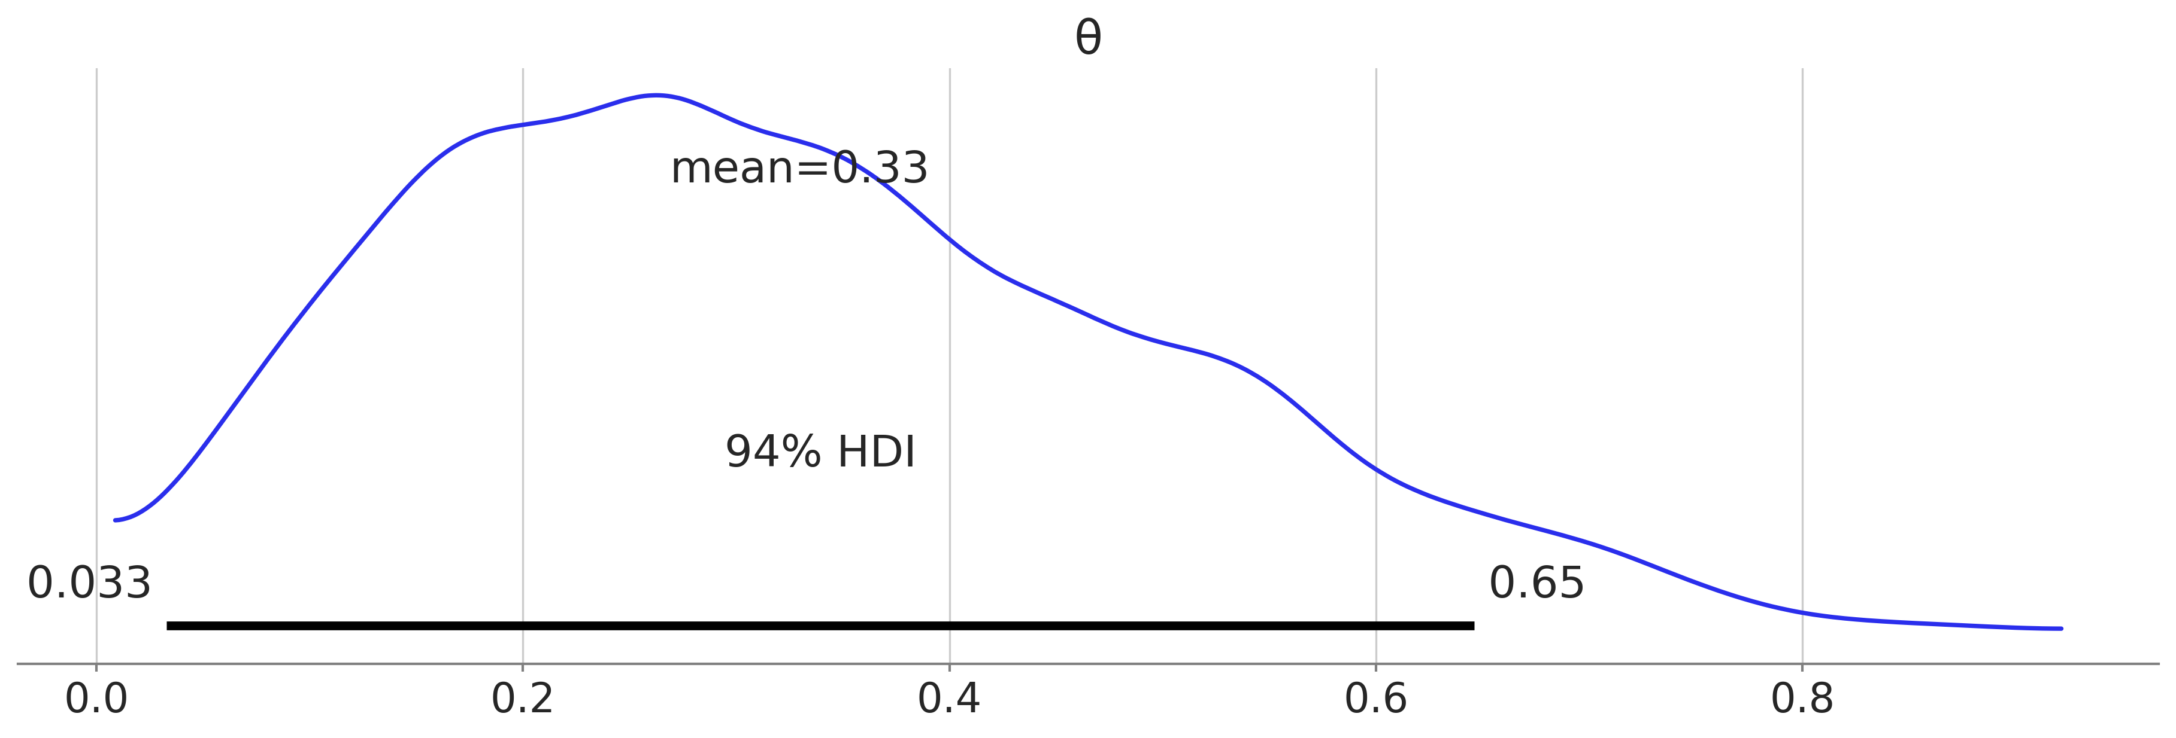
Examining the posterior distribution
az.summary(idata, kind="stats").round(2)
az.plot_posterior(idata, figsize=(12, 4))

Slide 40
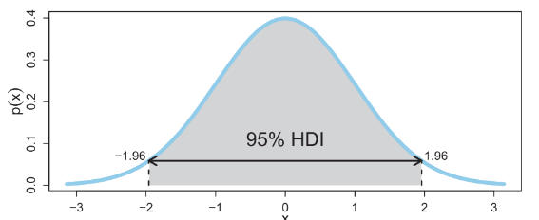
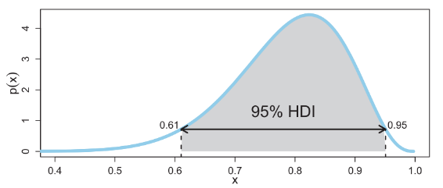
High density interval
An interval of largest values that contains 95% of the probability

Slide 41
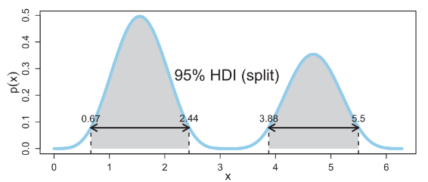
High density interval
An interval of largest values that contains 95% of the probability

Slide 42
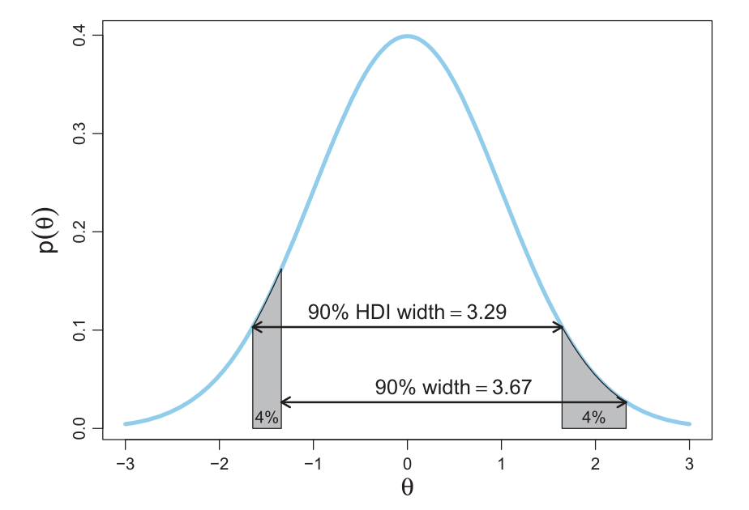
Logic of calculating HDI of a function
Unimodal
Univariate
HDI is the shortest interval

Slide 43
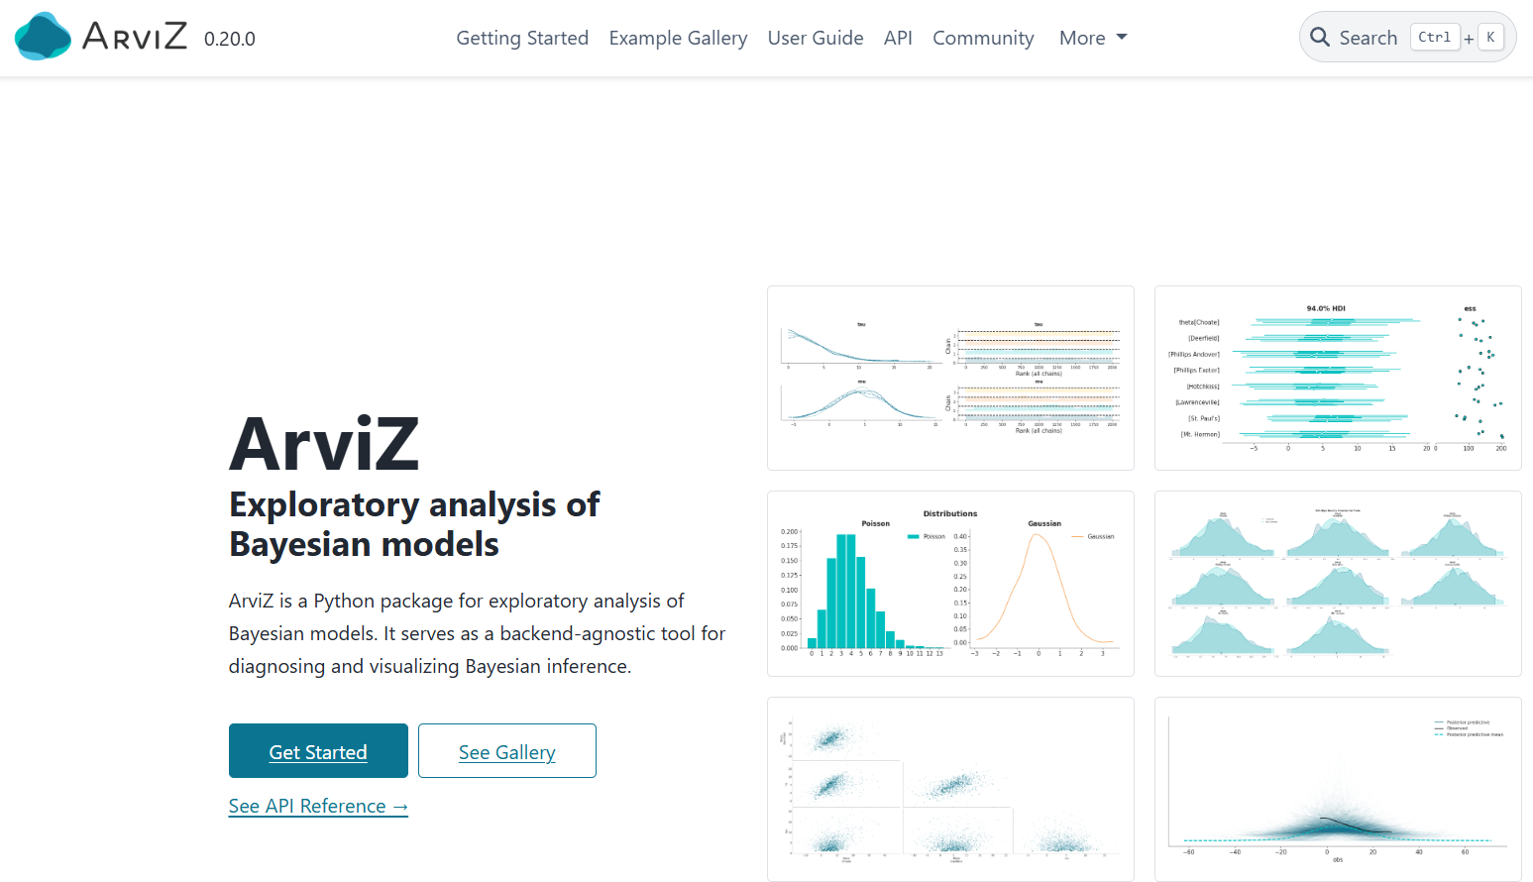
Arviz: Analyzing Bayesian data
https://python.arviz.org/en/stable/

Slide 44

Kahoot mid-lecture quiz

Slide 45
3D PyTensor

Slide 46
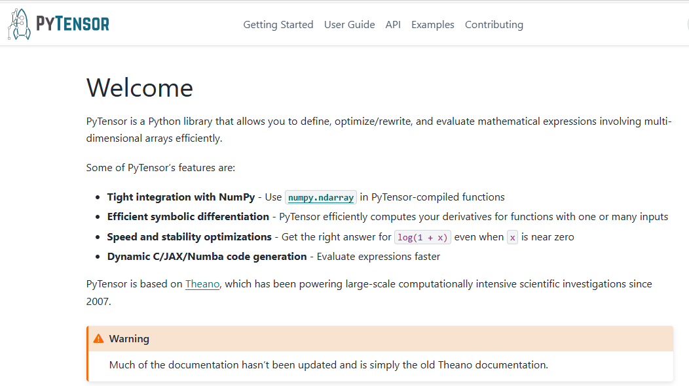
PyMC’s modeling back end

Slide 47
PyMC originally built on a deep learning framework
Theano was the first deep learning framework
Key features
Manipulation of functions
Multi-dimensional matrix manipulation
Automatic differentiation
PyTorch (Facebook) and TensorFlow (Google)
Build on Theano
Focused on fast computation for large matrixes
And made it obsolete
PyMC still needed Theano functionality
Symbolic tensor manipulation
Forked Theano to PyTensor

Slide 48
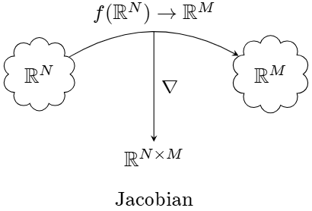
The Jacobian is a matrix that keeps track of partial derivatives for vector functions

Slide 49
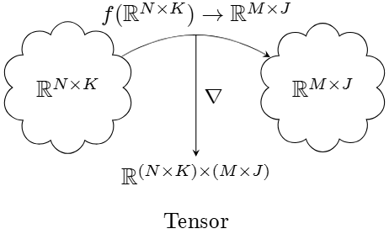
A tensor generalizes the Jacobian to keep track of partial derivatives for matrix functions

Slide 50
Tensor processing is important
Modern machine learning does calculations with very large multi-dimensional matrixes
Probabilistic models are nodes with multi-dimensional input and output
Both fields need automatic differentiation!

Slide 51
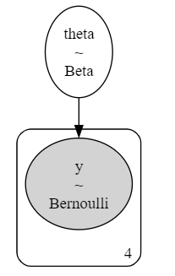
The PyMC graphical visualizer
Visualize any PyMC model
Shows: dimensionality, distributions, and dependencies
pm.model_to_graphviz(our_first_model)

Slide 52
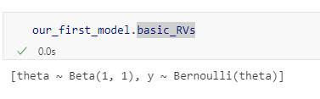
Each PyMC object is a PyTensor object
basic_RVs shows the random variables in our model

Slide 53
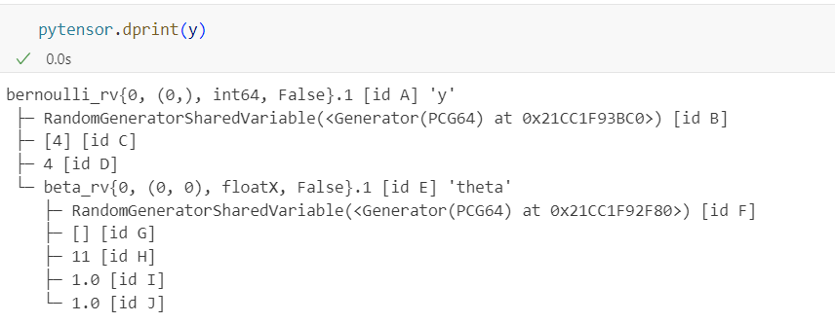
Each PyMC object is a PyTensor object
basic_RVs shows the random variables in our model
dprint show the graph of relationships
type
size
parameters

Slide 54
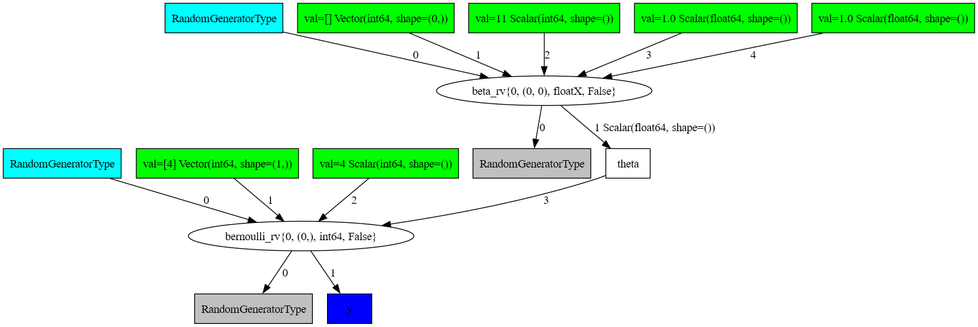
The PyTensor graphical visualization

Slide 55
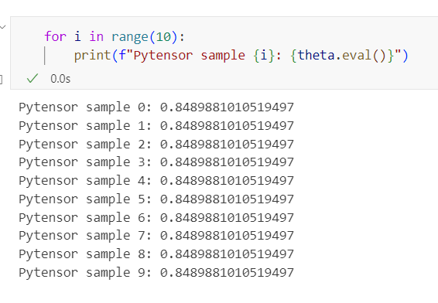
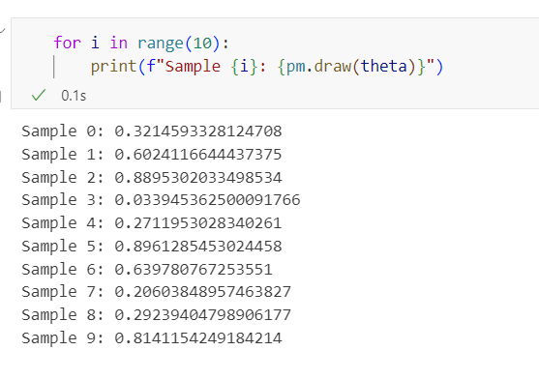
PyMC nodes are (often) PyTensor random variables
We can generate random values
PyTensor generates the same one each call
PyMC takes care of ‘reseeding’ the random number generator

Slide 56
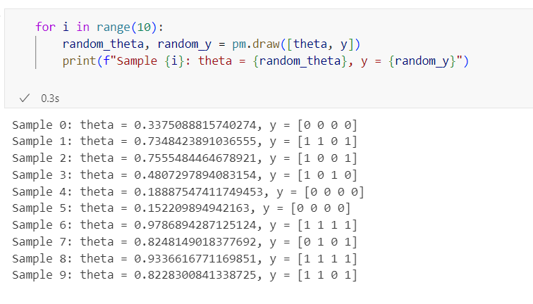
PyTensor cascades evaluation
Must draw theta in order to draw y

Slide 57
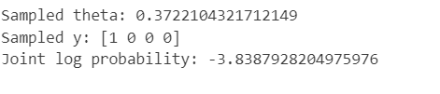
The log joint probability density function
PyMC uses PyTensor to create a function that gives the probability of parameters and data
from scipy import special
sample_theta = pm.draw(theta)
logp_func = our_first_model.compile_logp()
joint_logp = logp_func({"theta_logodds__": special.logit(sample_theta)})
print("Sampled theta:", sample_theta)
print("Sampled y:", data)
print("Joint log probability:", joint_logp)
The PyMC model uses a transformed value of theta. We will explain this in a few lectures.
The joint probability density

Slide 58
3F Testing fairness

Slide 59
Is this a fair coin?
0.5 falls inside the HDI

Slide 60
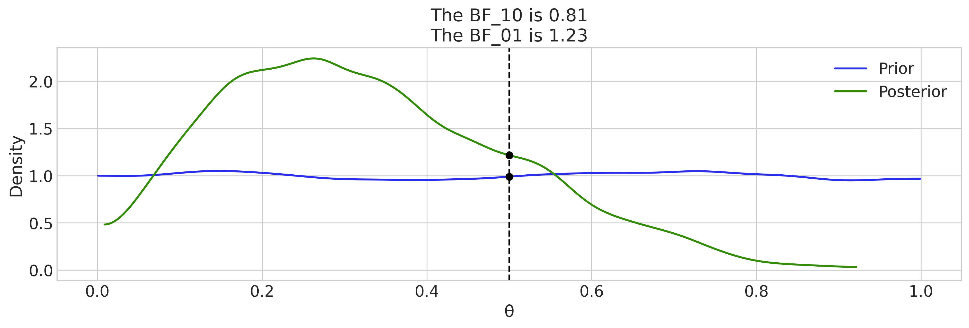
The Savage-Dickey density ratio
Ratio of prior and posterior density at a reference value
Measures evidence in data for or against that value
az.plot_bf(idata, var_name="θ", prior=np.random.uniform(0, 1, 10000), ref_val=0.5

Slide 61
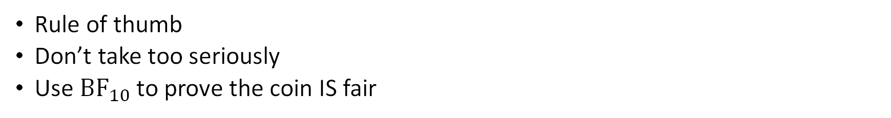
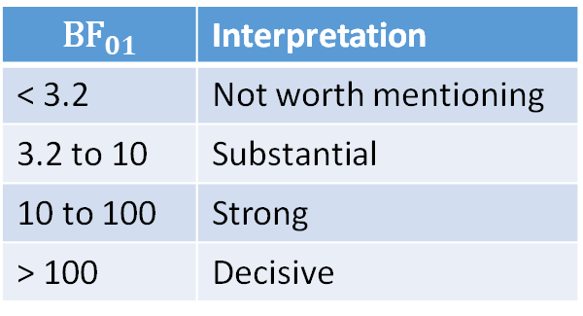
Interpreting the Savage-Dickey
Rule of thumb
Don’t take too seriously
Use ${\text{BF}}_{10}$ to prove the coin IS fair
$${\text{BF}}_{01}$$ | Interpretation
< 3.2 | Not worth mentioning
3.2 to 10 | Substantial
10 to 100 | Strong
> 100 | Decisive

Slide 62
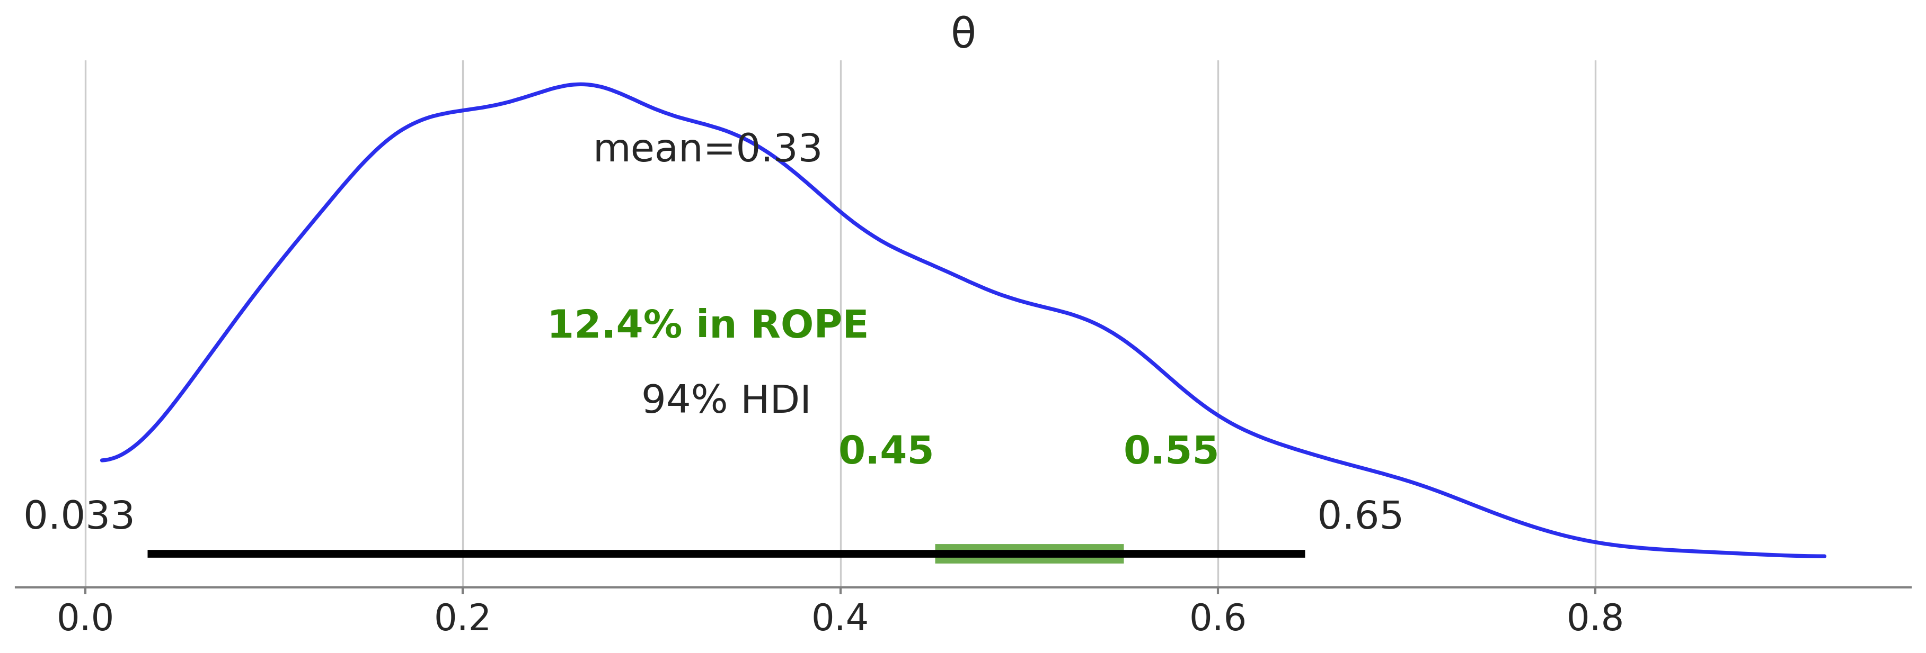
Region of Practical Equivalence (ROPE)
Region of near-fairness
Specified arbitrarily

Slide 63
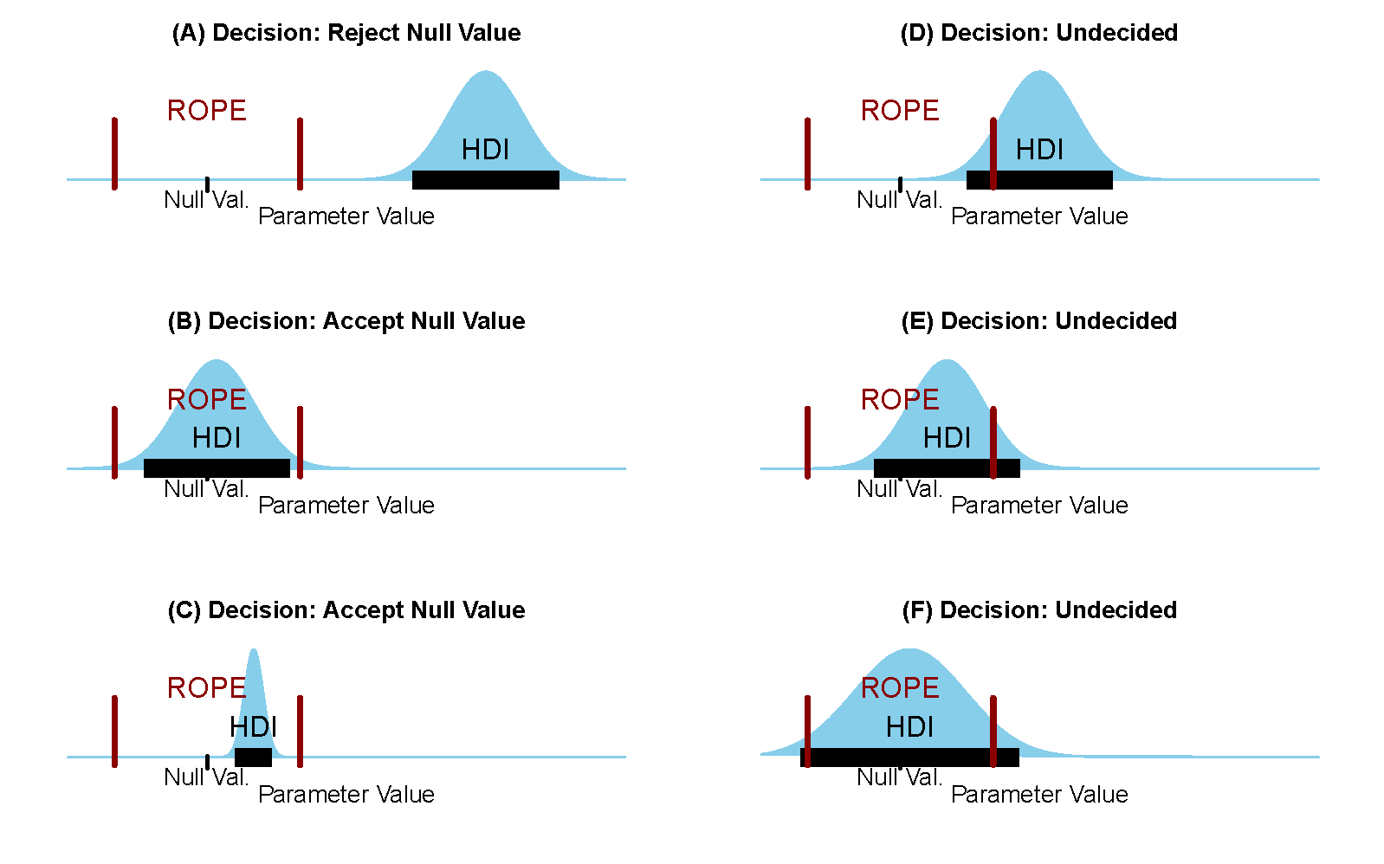
The ROPE and the HDI

Slide 64
2f Frequentist vs Bayesian

Slide 65
Bayesian analysis requires a prior
Using a prior has advantages:
It allows us to do Bayesian analysis and get a posterior
The posterior is a distribution that shows how credible different possibilities are
The posterior allows us to characterize our uncertainty
Posteriors average over priors
This means taking into account different possibilities
Makes conclusions more robust
Priors can regularize our results
That is, they allow more efficient and robust inference
Less overfitting (we will talk about overfitting)
Thinking about a prior requires you to think about the problem

Slide 66
Frequentist analysis rejects priors
Frequentists wanted an objective approach
Everyone must reach the same conclusion
No matter how weak the evidence
No prior means no distribution
Frequentist approaches focus on estimation
The idea is to find the best estimate
Often there are many choices

Slide 67

Maximum likelihood estimation
For $\hat{θ}$: the derivative is 0

Slide 68
Maximum likelihood estimation (2)
Solve for $θ$

Slide 69
The frequentist estimate through Bayesian eyes
Choose a uniform prior
Take the mode of the posterior and throw away the rest
Assume uniform prior
End up with maximum likelihood esitmate

Slide 70
The frequentist estimate through Bayesian eyes
Frequentism does choose a prior
Just not always the best one
Maximum likelihood is a summary of the posterior for this prior
Just not always the best one
Frequentism is like do Bayesian statistics badly

